Slide 1
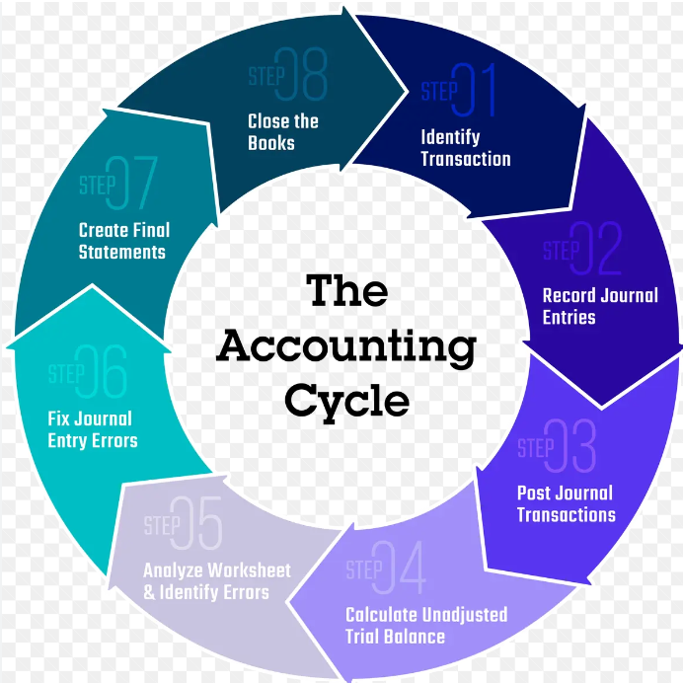
Chart of Accounts
Lesson 6.
Ph.D in Economic sciences,
Associate Professor
Ulan Moldokmatov

Slide 2
AGENDA
I. The concept of the chart of accounts, its purpose.
The structure of the plan of accounts of accounting.
II. The working chart of accounts - the basis of the system of organization of
accounting of economic entities. Registration of business transactions.

Slide 3
I. Permanent accounting accounts:
A Chart of Accounts (COA) in Kyrgyzstan serves as a framework for organizing all the financial transactions of a business. It aligns with the country's accounting standards, which may include specific account codes and structures required by local regulations, particularly for tax reporting and financial compliance.
Key Components of a Chart of Accounts:
Account Types:
  Assets: Accounts related to resources owned by the company (e.g., Cash, Accounts Receivable, Inventory).
  Liabilities: Accounts related to obligations owed by the company (e.g., Accounts Payable, Loans Payable).
  Equity: Accounts that represent the owner’s interest in the company (e.g., Common Stock, Retained Earnings).
  Revenue: Accounts that record income from the company’s operations (e.g., Sales Revenue, Service Income).
  Expenses: Accounts that record the costs incurred by the company (e.g., Rent Expense, Salaries Expense, Utility Expense).

Slide 4
CHART OF ACCOUNTS
1000 ‘Current assets’ (Short term assets)
1100 ‘Cash on hand’.
1110 ‘Cash in national currency’
1120 ‘Cash in foreign currency’
1130 ‘Cash documents’
1140 ‘Cash equivalents’
1200 ‘Monetary funds in bank’
1210 ‘Accounts in national currency’
1220 ‘Accounts in foreign currency with local banks’
1230 ‘Accounts in foreign banks’
1240 ‘Restricted cash in banks’
1250 ‘Cash in transit’
1300 ‘Short-term investments’
1310 ‘Debt securities’
1320 ‘Equity securities’
1330 ‘Credits, loans issued’
1340 ‘Deposits’
1350 ‘Current portion of long-term investments’
1350 ‘Current portion of long-term investments’ ‘Other short-term investments’
1400 ‘Accounts receivable’
1410 ‘Accounts receivable for goods and services’
1491 ‘Allowance for bad debts on accounts receivable’
1500 ‘Accounts receivable for other operations.
1510 ‘Notes receivable’
1520 ‘Receivables from employees and directors’
1530 ‘Taxes paid in advance’
1540 ‘Taxes refundable’
1550 ‘Interest receivable’
1560 ‘Dividends receivable’
1570 ‘Indebtedness of customers under construction contract’
1570 ‘Indebtedness of customers under construction contract’
1580 ‘Current portion of non-current receivables’
1590 ‘Other receivables’
1600 ‘Inventories’
1610 ‘Goods’
1691 ‘Unrealised trade mark-up’
1620 ‘Stocks of raw materials and basic materials’
1620 ‘Stocks of raw materials and basic materials’
1630 ‘Work in progress’
1640 ‘Finished goods’
1650 ‘Agricultural products from biological assets’
1700 ‘Stocks of auxiliary materials’
1710 ‘Fuel’
1720 ‘Spare parts’
1730 ‘Construction materials’
1740 ‘Other materials’
1750 ‘Low-value and wear-and-tear items’
1750 ‘Low-value and wear-and-tear items’
1795 ‘Low-value and wear-and-tear items in operation’
1795 ‘Low-value and wear-and-tear items in operation’
1800 ‘Advances issued’
1810 ‘Inventories paid in advance’
1810 ‘Inventories paid in advance’
1820 ‘Services paid in advance’
1830 ‘Rent paid in advance’
1830 ‘Rent paid in advance’
1890 ‘Other types of advance payments’
1890 ‘Other types of advance payments’
1900 ‘Indebtedness of founders (participants) on contributions to the authorised capital’.

Slide 5
2000 ‘Non-current assets’ (Long term assets)
2100 ‘Fixed assets’
2110 ‘Land’
2120 ‘Construction in progress
2130 ‘Buildings, constructions’
2193 ‘Accumulated depreciation - buildings, constructions’
2193 ‘Accumulated depreciation - buildings, constructions’
2140 ‘Equipment’
2194 ‘Accumulated depreciation - equipment’
2150 ‘Office equipment’
2195 ‘Accumulated depreciation - office equipment’
2195 ‘Accumulated depreciation - office equipment’
2160 ‘Furniture and fixtures’
2196 ‘Accumulated depreciation - furniture and supplies’
2196 ‘Accumulated depreciation - furniture and supplies’
2170 ‘Motor vehicles’
2197 ‘Accumulated depreciation - motor vehicles’
2197 ‘Accumulated depreciation - motor vehicles’
2180 ‘Leasehold improvements’
2180 ‘Leasehold improvements’
2198 ‘Accumulated depreciation - leasehold improvements’
2190 ‘Improvement of land plots’
2199 ‘Accumulated depreciation - improvement of land plots’
2200 ‘Biological assets’
2210 ‘Animals (consumable biological assets)’
2220 ‘Animals (fruiting biological assets)’
2230 ‘Plants (consumable biological assets)’
2240 ‘Fruiting plants’
2250 ‘Biological assets accounted for at cost’
2290 ‘Other biological assets’
2300 ‘Investment in real estate’
2310 ‘Land’
2320 ‘Buildings and constructions’
2330 ‘Reconstruction of real estate investment objects’
2400 ‘Deferred tax assets’
2500 ‘Restricted cash’.
2700 ‘Long-term receivables’
2710 ‘Bills of exchange received’
2720 ‘Long-term receivables from buyers and customers’
2780 ‘Non-current Deferred Expenses’
2790 ‘Other long-term receivables’
2800 ‘Long-term investments’
2810 ‘Debt securities’
2820 ‘Credits, loans issued’
2830 ‘Investments in subsidiaries’
2840 ‘Investments in joint operations’
2850 ‘Investments in associates’
2890 ‘Other long-term investments’
2900 ‘Intangible assets’
2910 ‘Franchise’
2991 ‘Accumulated amortisation - franchise’
2920 ‘Goodwill’
2992 ‘Accumulated amortisation - goodwill’
2930 ‘Patents’
2993 ‘Accumulated amortisation - patents’
2940 ‘Trade marks’
2994 ‘Accumulated amortisation - trademarks’
2950 ‘Copyrights’
2995 ‘Accumulated amortisation - copyrights’
2960 ‘Software’
2996 ‘Accumulated amortisation - software’
2970 ‘Licence agreement’
2997 ‘Accumulated amortisation - licence agreement’
2980 ‘Other assets’
2998 ‘Accumulated amortisation - other assets’
2990 ‘Development in progress’

Slide 6
3000 ‘Current liabilities’
3100 ‘Accounts payable’
3110 ‘Accounts payable for goods and services’
3190 ‘Other invoices payable’
3200 ‘Advances received’
3210 ‘Advances from buyers and customers’
3220 ‘Indebtedness to customers under construction contracts’
3300 ‘Short-term debt obligations’
3310 ‘Bank credits, loans’
3320 ‘Other credits, loans’
3330 ‘Current portion of long-term debt obligations’
3390 ‘Other short-term debt liabilities’
3400 ‘Taxes payable’
3410 ‘Income tax payable’
3420 ‘Personal income tax payable’
3430 ‘VAT payable’
3440 ‘Excises payable’
3490 ‘Other taxes payable’
3500 ‘Short-term accrued liabilities’
3510 ‘Accrued liabilities for payment for goods and services’
3520 ‘Accrued wages and salaries’
3530 ‘Accrued social security contributions’
3540 ‘Dividends payable’
3550 ‘Accrued interest on debt obligations’
3590 ‘Other accrued expenses’
3600 ‘Other short-term liabilities’
3700 ‘Reserves’
4000 ‘Long-term liabilities’
4100 ‘Long-term liabilities’
4110 ‘Bonds payable’
4120 ‘Bank credits, loans’
4130 ‘Other credits, loans’
4140 ‘Bills of exchange payable’
4150 ‘Finance Lease Obligations’
4190 ‘Other long-term liabilities’
4200 ‘Deferred income’
4300 ‘Deferred tax liabilities’
5000 ‘Equity capital’
5100 ‘Authorized capital’
5110 ‘Ordinary shares’
5120 ‘Preference shares’
5191 ‘Treasury shares’
5130 ‘Other authorized capital’
5200 ‘Other capital’
5210 ‘Additional paid-in capital’
5220 ‘Adjustments on revaluation of assets’
5230 ‘Foreign exchange differences on foreign currency transactions with foreign companies’
5240 ‘Capital advanced by owner(s)’
5300 ‘Retained earnings
5400 ‘Reserve capital’
5999 ‘Summary of income and expenses’

Slide 7
3000 ‘Current liabilities’
3100 ‘Accounts payable’
3110 ‘Accounts payable for goods and services’
3190 ‘Other invoices payable’
3200 ‘Advances received’
3210 ‘Advances from buyers and customers’
3220 ‘Indebtedness to customers under construction contracts’
3300 ‘Short-term debt obligations’
3310 ‘Bank credits, loans’
3320 ‘Other credits, loans’
3330 ‘Current portion of long-term debt obligations’
3390 ‘Other short-term debt liabilities’
3400 ‘Taxes payable’
3410 ‘Income tax payable’
3420 ‘Personal income tax payable’
3430 ‘VAT payable’
3440 ‘Excises payable’
3490 ‘Other taxes payable’
3500 ‘Short-term accrued liabilities’
3510 ‘Accrued liabilities for payment for goods and services’
3520 ‘Accrued wages and salaries’
3530 ‘Accrued social security contributions’
3540 ‘Dividends payable’
3550 ‘Accrued interest on debt obligations’
3590 ‘Other accrued expenses’
3600 ‘Other short-term liabilities’
3700 ‘Reserves’
4000 ‘Long-term liabilities’
4100 ‘Long-term liabilities’
4110 ‘Bonds payable’
4120 ‘Bank credits, loans’
4130 ‘Other credits, loans’
4140 ‘Bills of exchange payable’
4150 ‘Finance Lease Obligations’
4190 ‘Other long-term liabilities’
4200 ‘Deferred income’
4300 ‘Deferred tax liabilities’
5000 ‘Equity capital’
5100 ‘Authorized capital’
5110 ‘Ordinary shares’
5120 ‘Preference shares’
5191 ‘Treasury shares’
5130 ‘Other authorized capital’
5200 ‘Other capital’
5210 ‘Additional paid-in capital’
5220 ‘Adjustments on revaluation of assets’
5230 ‘Foreign exchange differences on foreign currency transactions with foreign companies’
5240 ‘Capital advanced by owner(s)’
5300 ‘Retained earnings
5400 ‘Reserve capital’
5999 ‘Summary of income and expenses’

Slide 8
7000 ‘Operating expenses’
7000 ‘Cost of sales of products and services determined by the continuous inventory method’
7000 ‘Cost of sales of products and services determined by the continuous inventory method
7100 ‘Cost of sales of products and services determined by the periodic inventory method’
7100 ‘Cost of sales of products and services determined by the continuous inventory method’
7110 ‘Acquisition costs of raw materials and supplies including returns’
7120 ‘Cost of sales of products and services determined by the periodic inventory method’
7120 ‘Labour costs’
7130 ‘Costs of contributions to the Social Fund’
7140 ‘Expenses for public utilities’ 7140 ‘Expenses for public utilities’
7150 ‘Costs of depreciation of fixed production assets’
7160 ‘Costs of repair and maintenance of fixed assets’
7170 ‘Other production costs’
7180 ‘Utilisation of product inventories for own needs’
7190 ‘Adjustments to inventories
7200 ‘Cost of goods sold determined by the continuous inventory method (trade)
7200 ‘Cost of goods sold determined by the periodic method (trade)’
7210 ‘Purchase of goods’
7220 ‘Return of purchased goods’
7230 ‘Utilization of goods for own needs’
7290 ‘Adjustments to the cost of inventories’
7300 ‘Production costs of biological assets’.
7400 ‘Construction contract costs’
7500 ‘Expenses related to realization’
7510 ‘Advertising and Sales Promotion Expenses’
7520 ‘Expenses for payment of salaries’
7530 ‘Expenses for contributions to the Social Fund’
7540 ‘Expenses for storage and transport costs’
7550 ‘Expenses on bad debts related to sales’
7560 ‘Warranty service costs’
7570 ‘Other trade costs’
7580 ‘Depreciation expenses on fixed assets’
7590 ‘Expenses for premium sales’
7600 ‘Other production costs’
6000 ‘Income from operating activities’
6100 ‘Revenue’
6110 ‘Revenue from sale of goods and services’
6120 ‘Return of sold goods and discounts’
6120 ‘Return of goods sold and discounts’
6130 ‘Revenue from exchange of goods and services’
6130 ‘Revenue from exchange of goods and services’
6140 ‘Revenue from construction contracts.
6150 ‘Revenue from the use by other organizations
of the subject's assets’
6140 ‘Revenue from construction contracts’
6160 ‘Revenues from insurance contracts.
6200 ‘Other income from operating activities’
6300 ‘Profit (loss) from biological assets’
6300 ‘Profit (loss) from biological assets’
6310 ‘Profit (loss) from initial recognition of biological assets’
6310 ‘Profit (loss) from biological assets’
6320 ‘Profit from harvesting agricultural products’
6320 ‘Profit (loss) from initial recognition of biological assets’
6330 ‘Gain (loss) on change in fair value of biological assets’
6330 ‘Gain (loss) on change in fair value of biological assets’

Slide 9
8000 ‘General and administrative expenses’
8010 ‘Labor expenses’
8020 ‘Social Fund Contribution Expenses’
8030 ‘Expenses on rent payment’
8040 ‘Expenses on payment for services’
8050 ‘Property tax’
8060 ‘Expenses for office supplies’
8070 ‘Communication expenses’
8080 ‘Insurance expenses’ 8080 ‘Insurance costs’
8090 ‘Expenses for licenses and other agreements’
8100 ‘Expenditure on VAT not eligible for credit’.
8110 ‘Repair and maintenance of fixed assets’
8120 ‘Expenses on computer software - software’
8130 ‘Representation expenses’
8140 ‘Remuneration of auditors’
8150 ‘Remuneration of lawyers’
8160 ‘Training expenses’
8170 ‘Consultancy expenses’
8180 ‘Public Relations Expenses’
8190 ‘Expenses for other taxes’
8200 ‘Travelling expenses (local)’
8210 ‘Travelling expenses (international)’.
8220 ‘Utility expenses’ .
8230 ‘Fines, penalties, forfeits to the budget’ .
8240 ‘Fines, penalties, forfeits under economic contracts’ .
8300 ‘Expenses on research and scientific development’ .
8470 ‘Expenses on amortisation of fixed assets’
8480 ‘Expenses on amortisation of intangible assets’
8490 ‘Other general and administrative expenses.
9000 ‘Non-operating income and expenses’
9100 ‘Income from non-operating activities’
9110 ‘Interest income’
9120 ‘Income from associates, subsidiaries’
9130 ‘Dividend income’
9140 ‘Foreign exchange gain on foreign currency transactions’
9190 ‘Other non-operating income’
9500 ‘Non-operating expenses’
9510 ‘Interest expense’
9520 ‘Losses from exchange rate differences on operations in foreign currency’
9530 ‘Expenses on bad debts’
9590 ‘Other non-operating expenses’
9800 ‘Extraordinary items’
9810 ‘Extraordinary profit’
9820 ‘Extraordinary loss’
9900 ‘Income Taxes’
9910 ‘Income tax expense (income)’

Slide 10
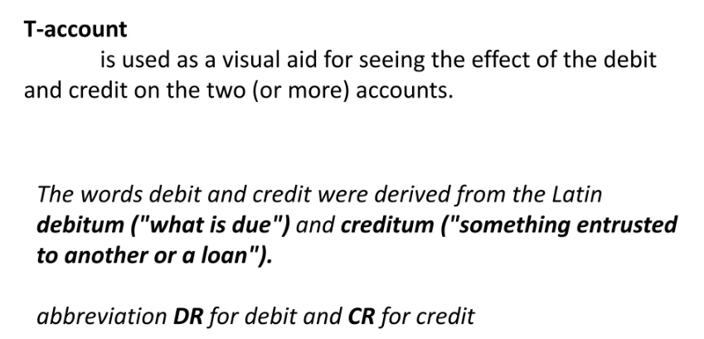
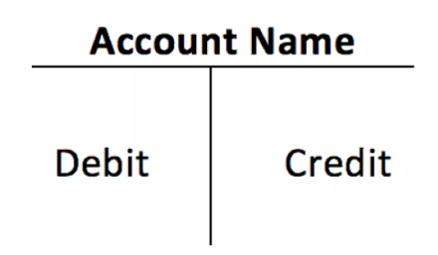
II.

Slide 11
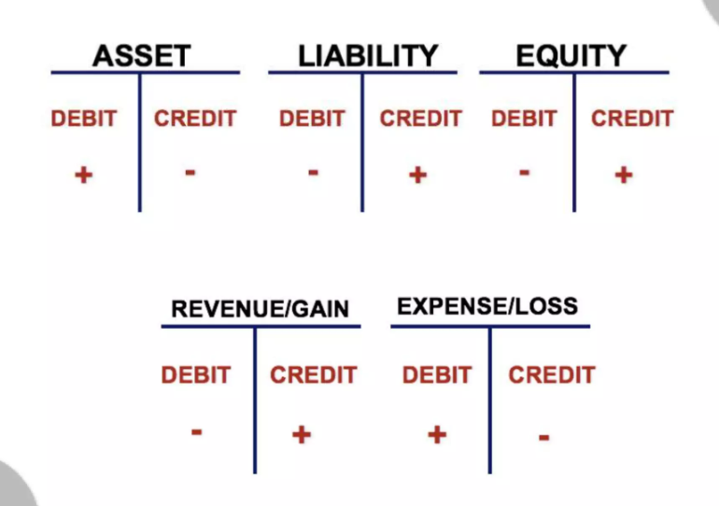

Slide 12
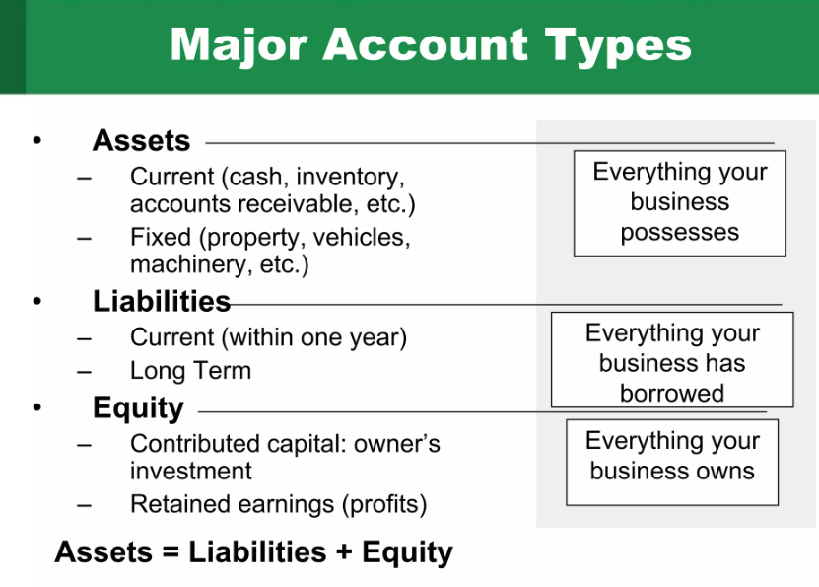

Slide 13
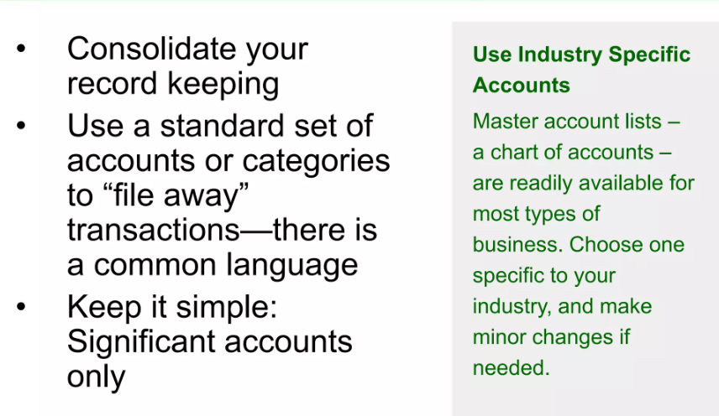
II.

Slide 14
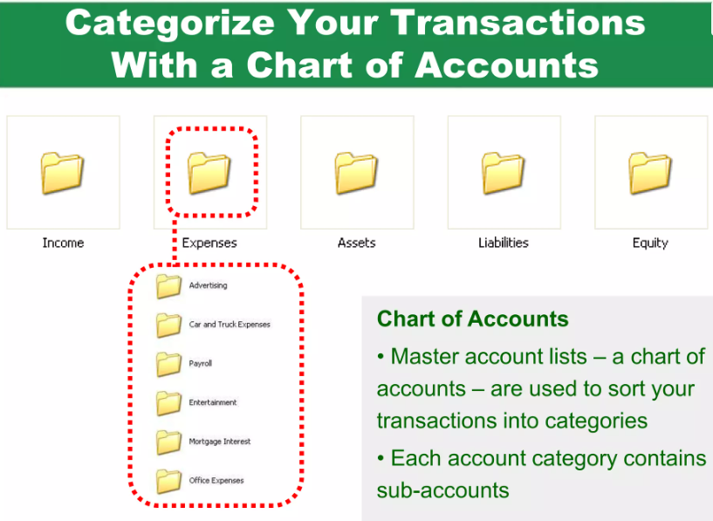

Slide 15
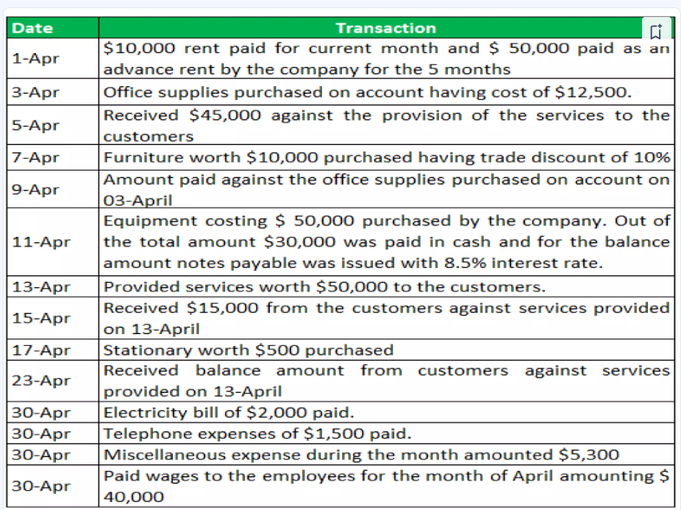

Slide 16
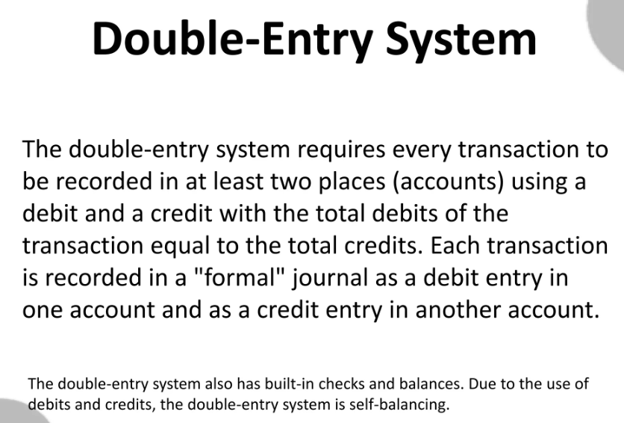

Slide 17
Illustration of Double – entry:
October 4, 20XX Department purchased 100 $ worth of office supplies in cash.
Debet (2150) Office Supplies 100 $
Credit (1100) Cash 100$
Purchased of office supplies in cash

Slide 18
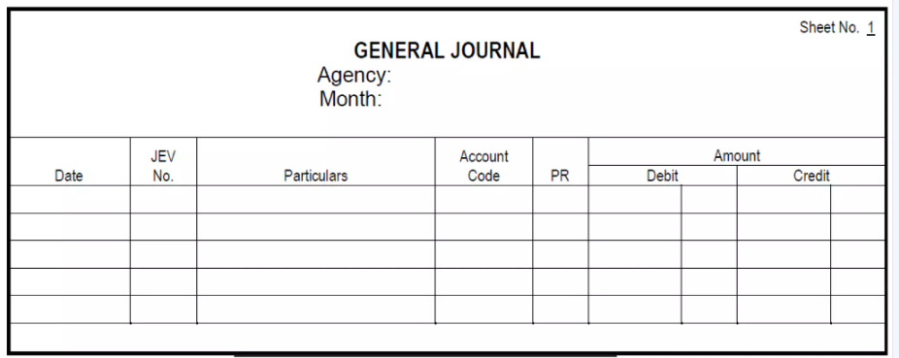

Slide 19
QUESTIONS
What is the main purpose of a Chart of Accounts (COA)?
How is the Chart of Accounts used in organizing a company’s financial transactions?
What are the five main account types in the Chart of Accounts?
Give three examples of accounts under “Assets.”
What types of accounts are included under “Liabilities”?
What does “Equity” represent in the Chart of Accounts?
Provide two examples of “Revenue” accounts.
Give two examples of “Expense” accounts.
What is the account code for “Cash on hand”?
Under which category does the account “Accounts receivable” belong?
What is the difference between “Current assets” and “Non-current assets”?
What does account code 2100 represent?
What is the account code for “Accumulated depreciation – buildings, constructions”?
List two examples of intangible assets and their codes.
What is the code for “Accounts payable for goods and services”?
Which account records “Income tax payable”?
What code represents “Authorized capital”?
What type of transactions are recorded under the code 6000–7000?
Give two examples of “Operating expenses.”
Which accounts are used for “Non-operating income”?
What is the account code for “Interest expense”?
Which account is used to record “Extraordinary profit”?
What is the meaning of “Double-entry accounting”?
Illustrate the double-entry for purchasing office supplies in cash for $100.
Why is it important to maintain a standardized Chart of Accounts?

Slide 20
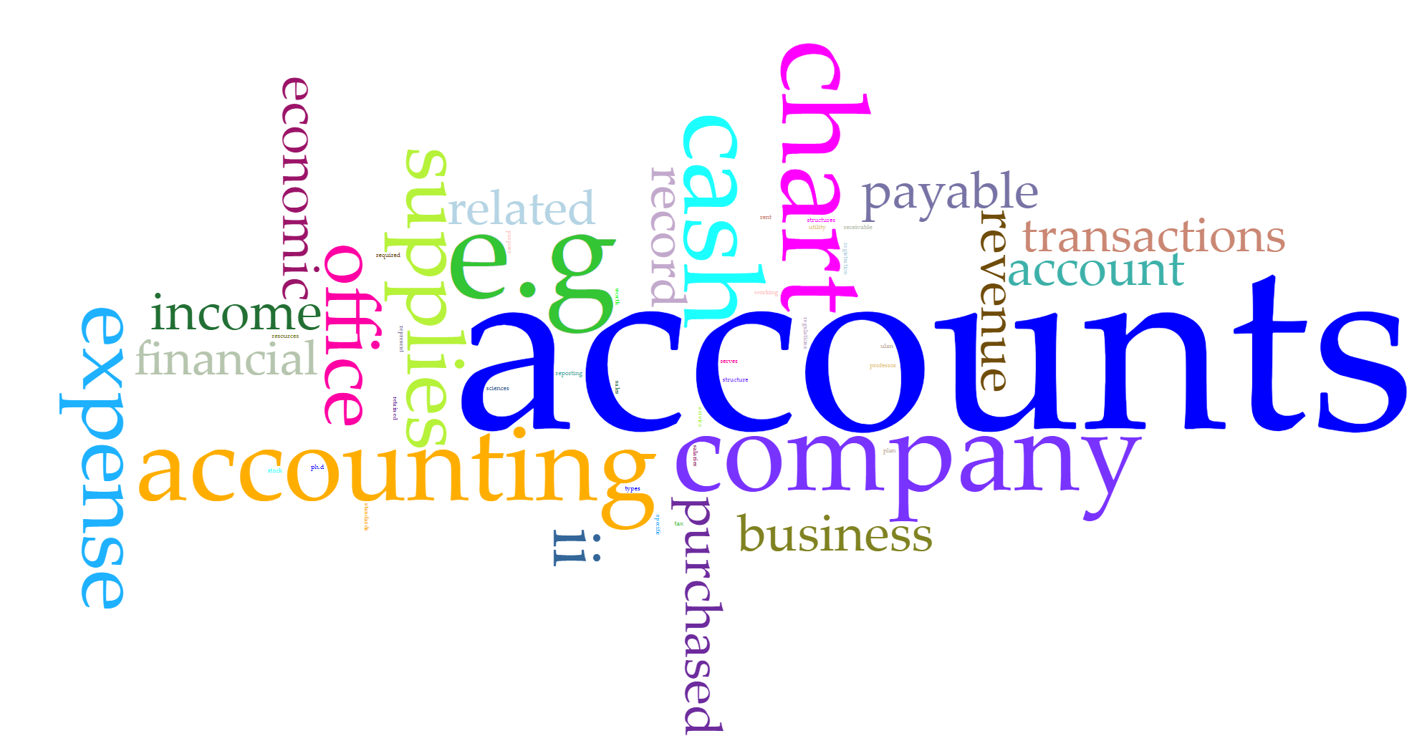
Thanks for your attention!!!

